Slide 1
AVIATION EVALUATION
PRIVATE AND COMMERCIAL AIRCRAFT ANALYSIS

Slide 2
AVIATION EVALUATION
PRIVATE AND COMMERCIAL AIRCRAFT ANALYSIS

Slide 3
BUSINESS UNDERSTANDING
Objective: The primary goal is to assess the risks associated with different aircraft models to guide the company and stakeholders decision on which aircraft to purchase for commercial and private enterprises as part of its diversification strategy.
Understanding the aviation industry landscape is essential for stakeholders as they explore diversification. This involves recognizing market dynamics, Aircraft models, and risks associated with the aviation industry.
We must fulfill the following to provide recommendations to the stakeholders:
-Stake holders goals
-Risk aversion(accidents,fatalities,injuries...etc)
-Financial considerations

Slide 4
DATA UNDERSTANDING
-***Data understanding involves gathering and exploring relevant data*** to gain insights into the aviation industry and aircraft models.
-Key aspects include **assessing data quality, completeness, and relevance, as well as understanding the variables.**

Slide 5
DATA CLEANING
After understanding the kind of data we have access to we must clean it
-Data cleaning is a critical process that involves **identifying and rectifying inaccuracies, inconsistencies, and missing values within the collected datasets.**
- We identified the percentage(%) of total number of values missing in all columns.This provides a basis on each column and their relevance to provide key insights to our project.
- Columns missing a higher % of data are dropped and columns not required in our analysis are dropped eg. Latitude,Longitude,Schedule...etc
-We the remove duplicates, standarde formats, filling in missing information through estimation

Slide 6
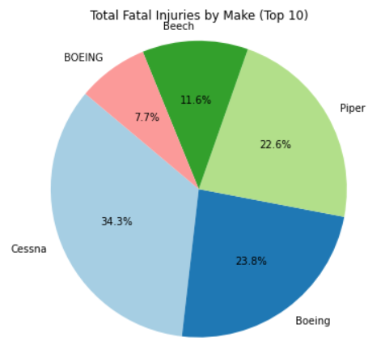
DATA VISUALIZATION
PIE-CHART OF MOST FATAL MAKES

Slide 7
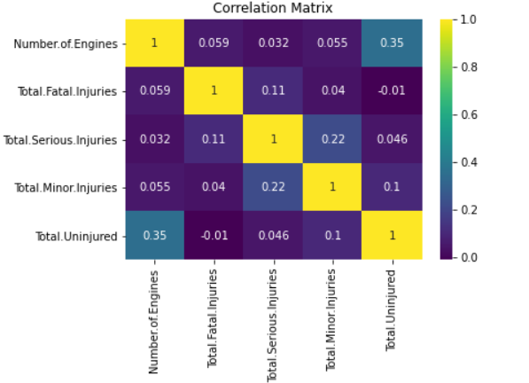
2. CORRELATION COEFFICIENT OF NUMBER OF ENGINES TO TOTAL INJURIES

Slide 8
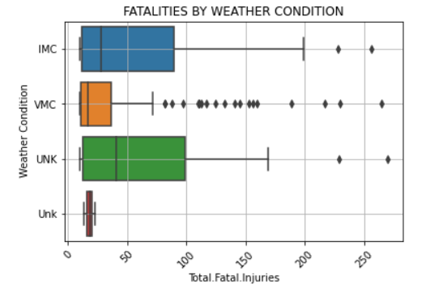
3. BOXPLOT TO SHOW US THE RELATION BETWEEN TOTAL FATALITIES AN D WEATHER CONDITION

Slide 9
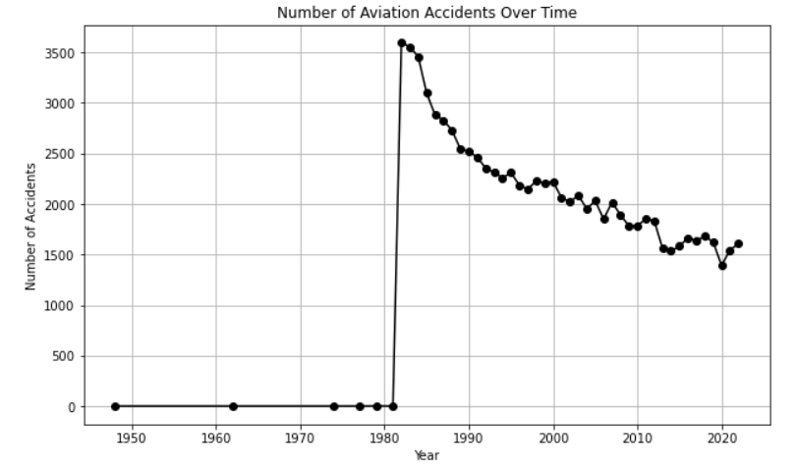
4. LINEGRAPH TO SHOW NUMBER OF FATALITIES OVER TIME

Slide 10
RECOMMANDATIONS
following analysis and every other step above the following would be my recommendations:
-**Prioritize purchase of newer aircrafts**- the line graph showed us us time went on the newer planes were less likely to get in accidents based of on the data
-**Consider routes with better weather conditions** - the boxplot shows us that the weather was a considerable factor when considering the likely-hood of an accident, better weather would be something to consider in terms of the aircrafts route
-**public sector would be a better investment than private sector**- planes used for the purpose of private usage were more likely to crash.

Slide 11
THE END
BY IMRAN AWADH MAHFOUDH

Slide 12
BUSINESS UNDERSTANDING
Objective: The primary goal is to assess the risks associated with different aircraft models to guide the company and stakeholders decision on which aircraft to purchase for commercial and private enterprises as part of its diversification strategy.
Understanding the aviation industry landscape is essential for stakeholders as they explore diversification. This involves recognizing market dynamics, Aircraft models, and risks associated with the aviation industry.
We must fulfill the following to provide recommendations to the stakeholders:
-Stake holders goals
-Risk aversion(accidents,fatalities,injuries...etc)
-Financial considerations

Slide 13
DATA UNDERSTANDING
-***Data understanding involves gathering and exploring relevant data*** to gain insights into the aviation industry and aircraft models.
-Key aspects include **assessing data quality, completeness, and relevance, as well as understanding the variables.**

Slide 14
DATA CLEANING
After understanding the kind of data we have access to we must clean it
-Data cleaning is a critical process that involves **identifying and rectifying inaccuracies, inconsistencies, and missing values within the collected datasets.**
- We identified the percentage(%) of total number of values missing in all columns.This provides a basis on each column and their relevance to provide key insights to our project.
- Columns missing a higher % of data are dropped and columns not required in our analysis are dropped eg. Latitude,Longitude,Schedule...etc
-We the remove duplicates, standarde formats, filling in missing information through estimation

Slide 15
DATA VISUALIZATION
PIE-CHART OF MOST FATAL MAKES

Slide 16
2. CORRELATION COEFFICIENT OF NUMBER OF ENGINES TO TOTAL INJURIES

Slide 17
3. BOXPLOT TO SHOW US THE RELATION BETWEEN TOTAL FATALITIES AN D WEATHER CONDITION

Slide 18
4. LINEGRAPH TO SHOW NUMBER OF FATALITIES OVER TIME

Slide 19
RECOMMANDATIONS
following analysis and every other step above the following would be my recommendations:
-**Prioritize purchase of newer aircrafts**- the line graph showed us us time went on the newer planes were less likely to get in accidents based of on the data
-**Consider routes with better weather conditions** - the boxplot shows us that the weather was a considerable factor when considering the likely-hood of an accident, better weather would be something to consider in terms of the aircrafts route
-**public sector would be a better investment than private sector**- planes used for the purpose of private usage were more likely to crash.

Slide 20
THE END
BY IMRAN AWADH MAHFOUDH

